Slide 1

Music Data Analysis
Aidan Lucero, Amelia Corea, & Everett Waterman

Slide 2
Overview
Utilize data sets from multiple sources to provide an interactive dashboard including drop down charts, user input, and semi-static images pulling from a backend music chart data-driven API and Spotify Top 200 & Viral 50 data source.

Slide 3



The Data- Sources & Cleanup
Python Flask API
Spotify?
LastFM?
AudioDB?
One Database
Spotify Dataset from Kaggle (Top 200 and Viral 50 from 2017 to current)
Reduced data using EmEditor to just USA data and removed spotify URL link.
Created SQL table using Postgres
Impost Dataset
Javascript/HTML
Dashboard view
Multiple pages

Slide 4
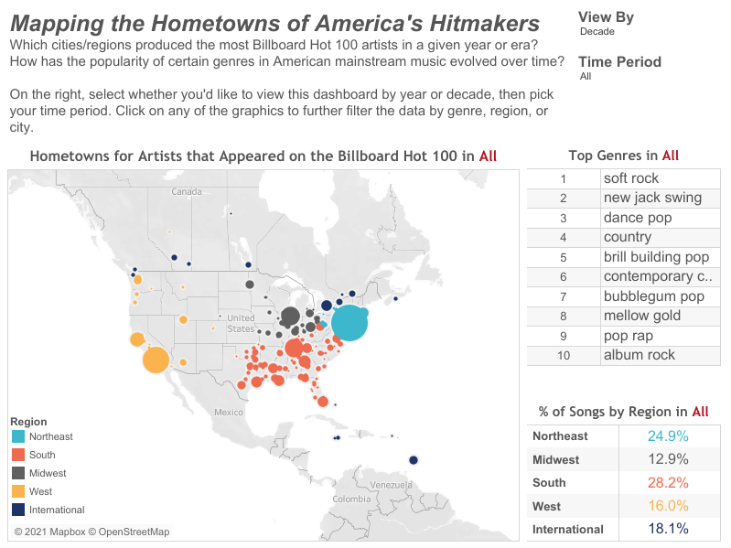
Visualizations

Slide 5
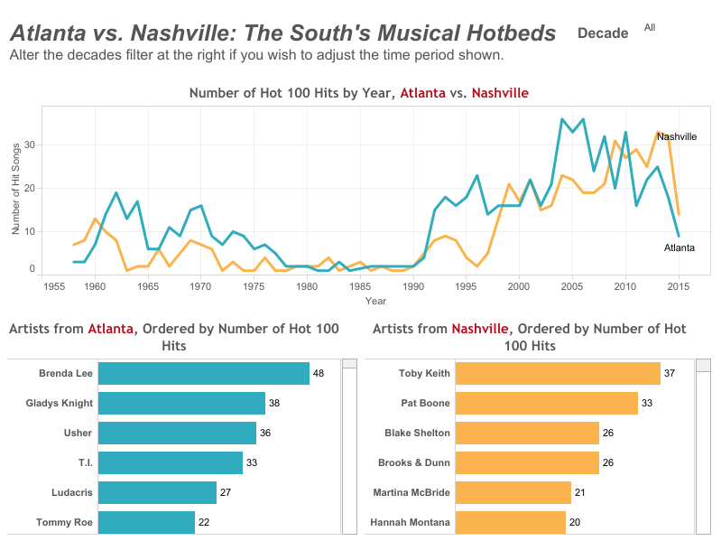
Visualizations

Slide 6
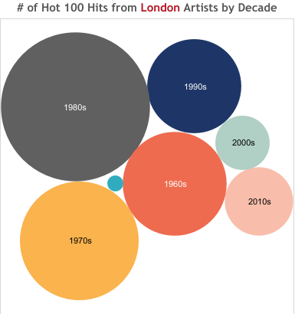
Visualizations

Slide 7
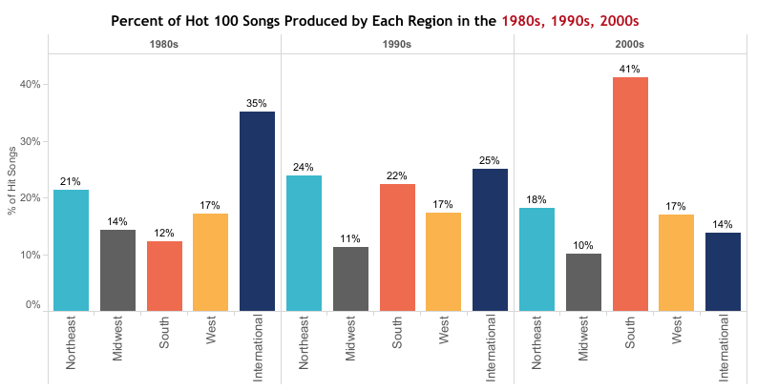
Visualizations

Slide 8

Thank you

